Slide 1

Cyclistic Bike-Share:
Converting Casual Users to Members
December 2023
Afia Ali

Slide 2
Background
Launched in 2016 in Chicago
Total of 5,824 bicycles over 692 stations
Annual members are more profitable than casual riders

Slide 3
Objectives
Share how annual members and casual riders differ in their use of Cyclists' bikeshare
Identify how Cyclistic can use digital media to increase memberships
Explore how casual riders can be converted into members

Slide 4
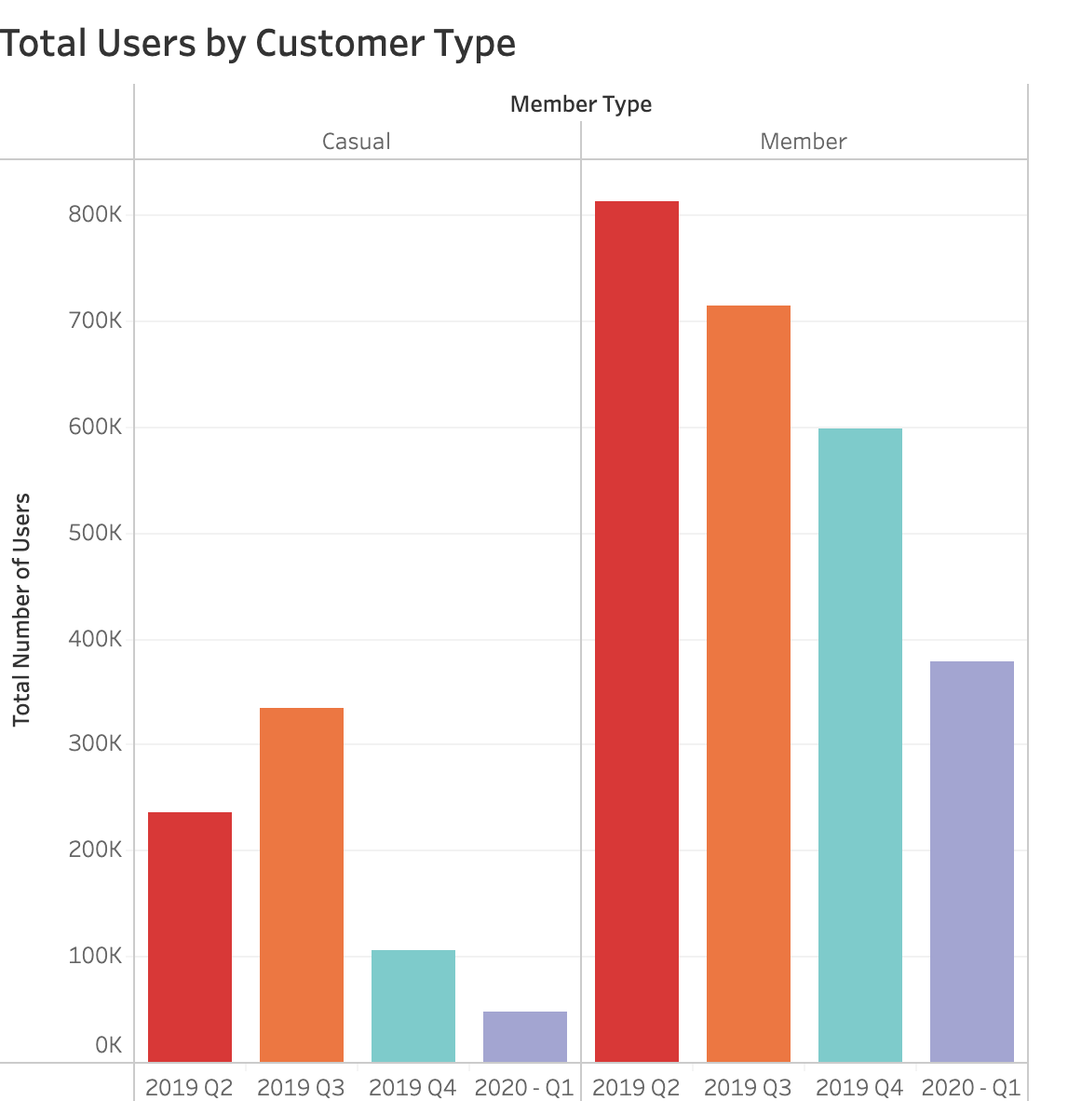
Total Users by Customer Type
Larger number of users are members
Number of casual riders higher in Q3
Summer months
Holidays
Decline in total users for both casual and member users in both Q4 and Q1
Colder weather
COVID 19

Slide 5
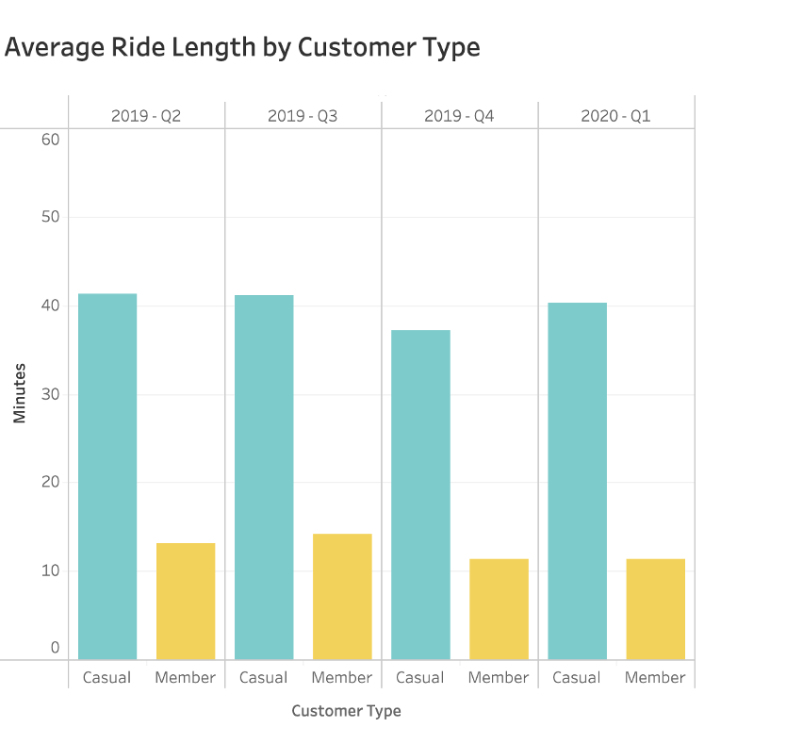
Average Ride Length by Customer Type
Casual members
Longer average usage time
Leisure
Members
– Shorter average usage time
– Short travels – commuting?

Slide 6
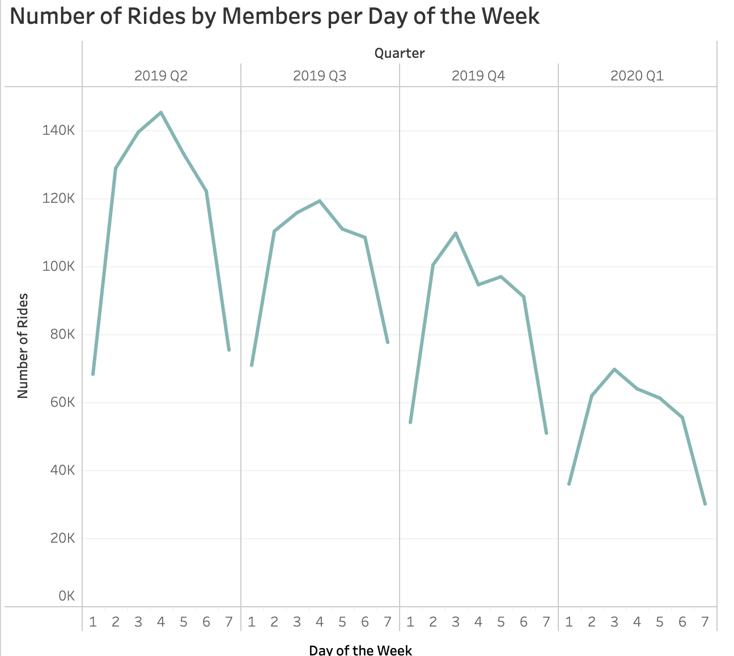
Member Activity per Day of the Week
Wednesday most popular day of week for Q2 and Q3
Tuesdays most popular day of the week in Q4 and Q1
Saturday and Sunday have lowest relative number of riders in all quarters
Note: 1= Sunday and 7 = Saturday

Slide 7
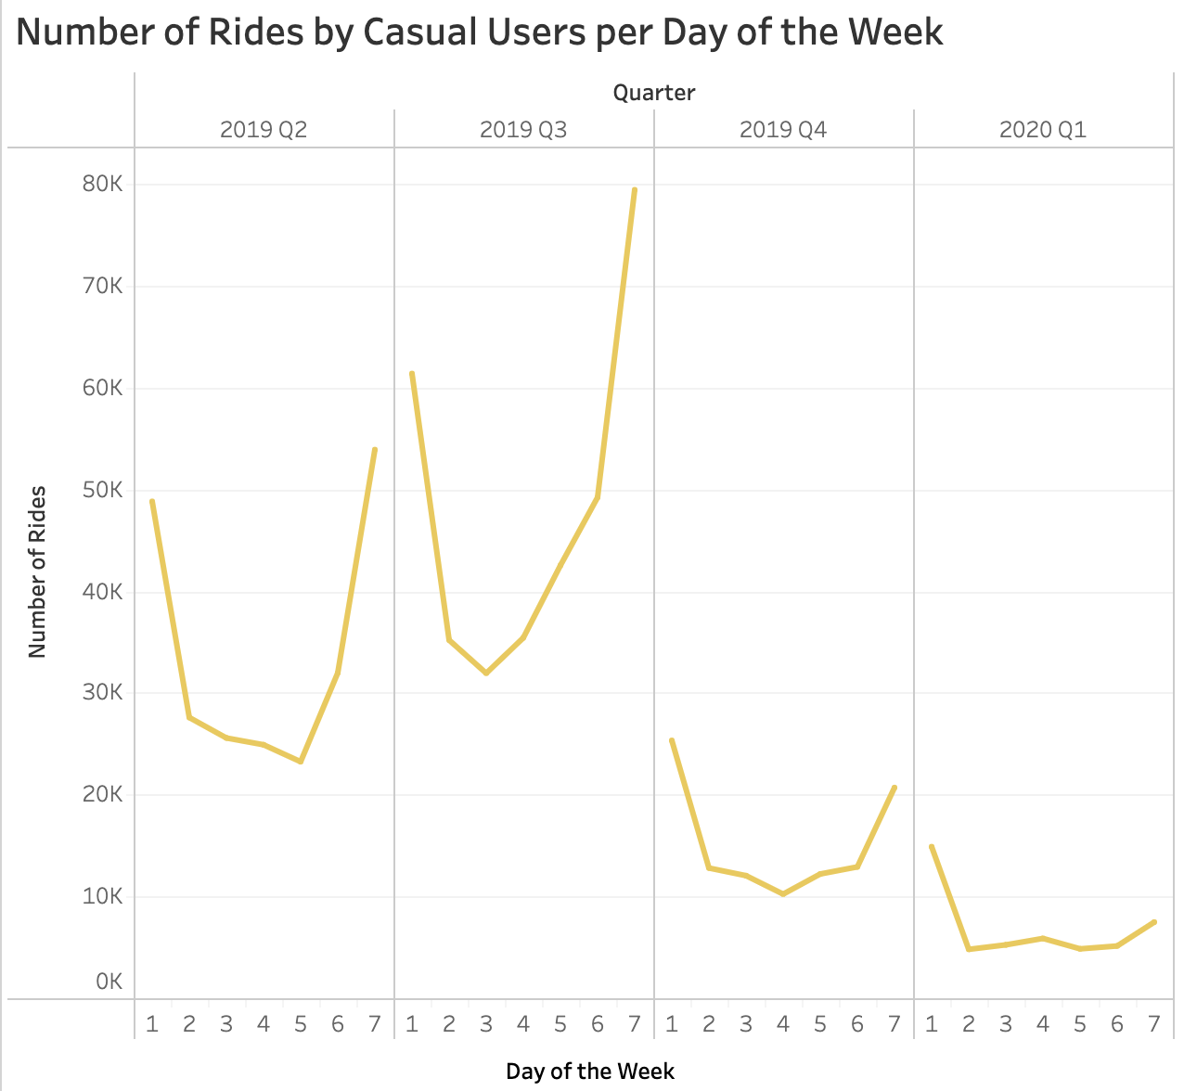
Casual User Activity per Day of the Week
Saturday and Sundays are the most popular day of the week for all quarters
Lower activity throughout the rest of the week
Note: 1= Sunday and 7 = Saturday

Slide 8
Key Findings
Members use of bikes is significantly higher than casual riders
Highest number of total causal riders is during the summer months
Casual riders have longer average use time than members
Casual rider activity is greater on weekends

Slide 9
How To Convert Casual Riders to Members
Look into the pricing strategy
Summer months memberships
Weekend use membership
1 month discount for first subscription

Slide 10
Using Digital Media to Increase Memberships
Increase advertisement during the warmer months
Offer and promote discount for first subscription/ discounts for students
Hold a cycling event to showcase what Cyclistic has to offer
- Invite social media fitness instructors/ cyclists to join the event and promote the company

Slide 11
Appendix
Data source: https://divvy-tripdata.s3.amazonaws.com/index.html

